Slide 1
Developing and Managing Great Recovery Residence Provider Organizations

Slide 2
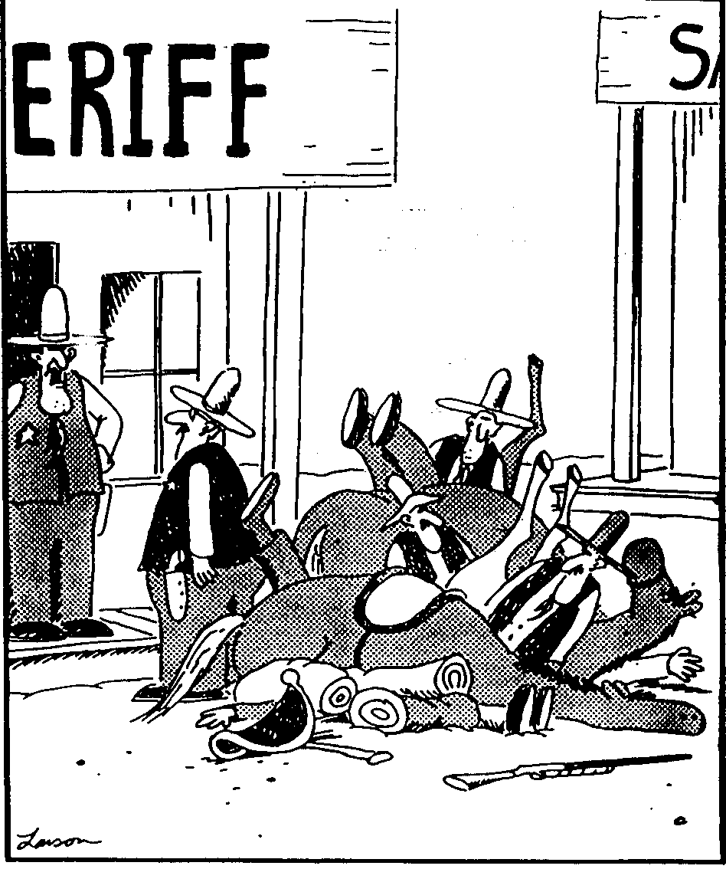
“And so you just threw everything together? . . .
Mathews, a posse is something you have to organize.”
The Far Side, Gary Larson

Slide 3



Peer-based organization
Our
Recovery Residence
Association

Slide 4
What is our organization’s purpose?
Establish, maintain standards
Resolve disputes
Raise the bar (standards, mutual expectations)
Share, gain knowledge
Increase public understanding, respect
Establish, maintain a “place at the table” for recovery residences

Slide 5
Who are our organization’s stakeholders?

Slide 6
Relationships: a members’ view
Families
Communities
Providers of allied services
Supporters
Accreditation, support orgs.
Regulatory orgs.
Services finance
ME
Capacity finance
Residents

Slide 7
Relationships: our association’s view
Families
Communities
Residents
State regulators
MEMBERS
Our
Recovery Residence
Association
Services finance
Providers of related services
Federal agencies
Accreditation, support orgs.
Supporters

Slide 8
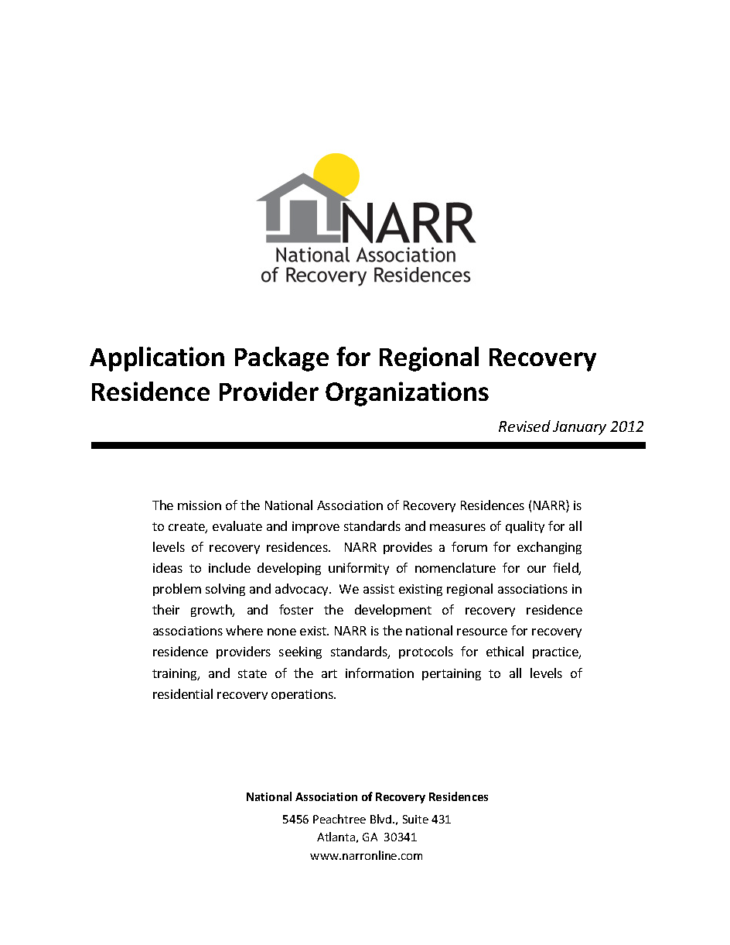
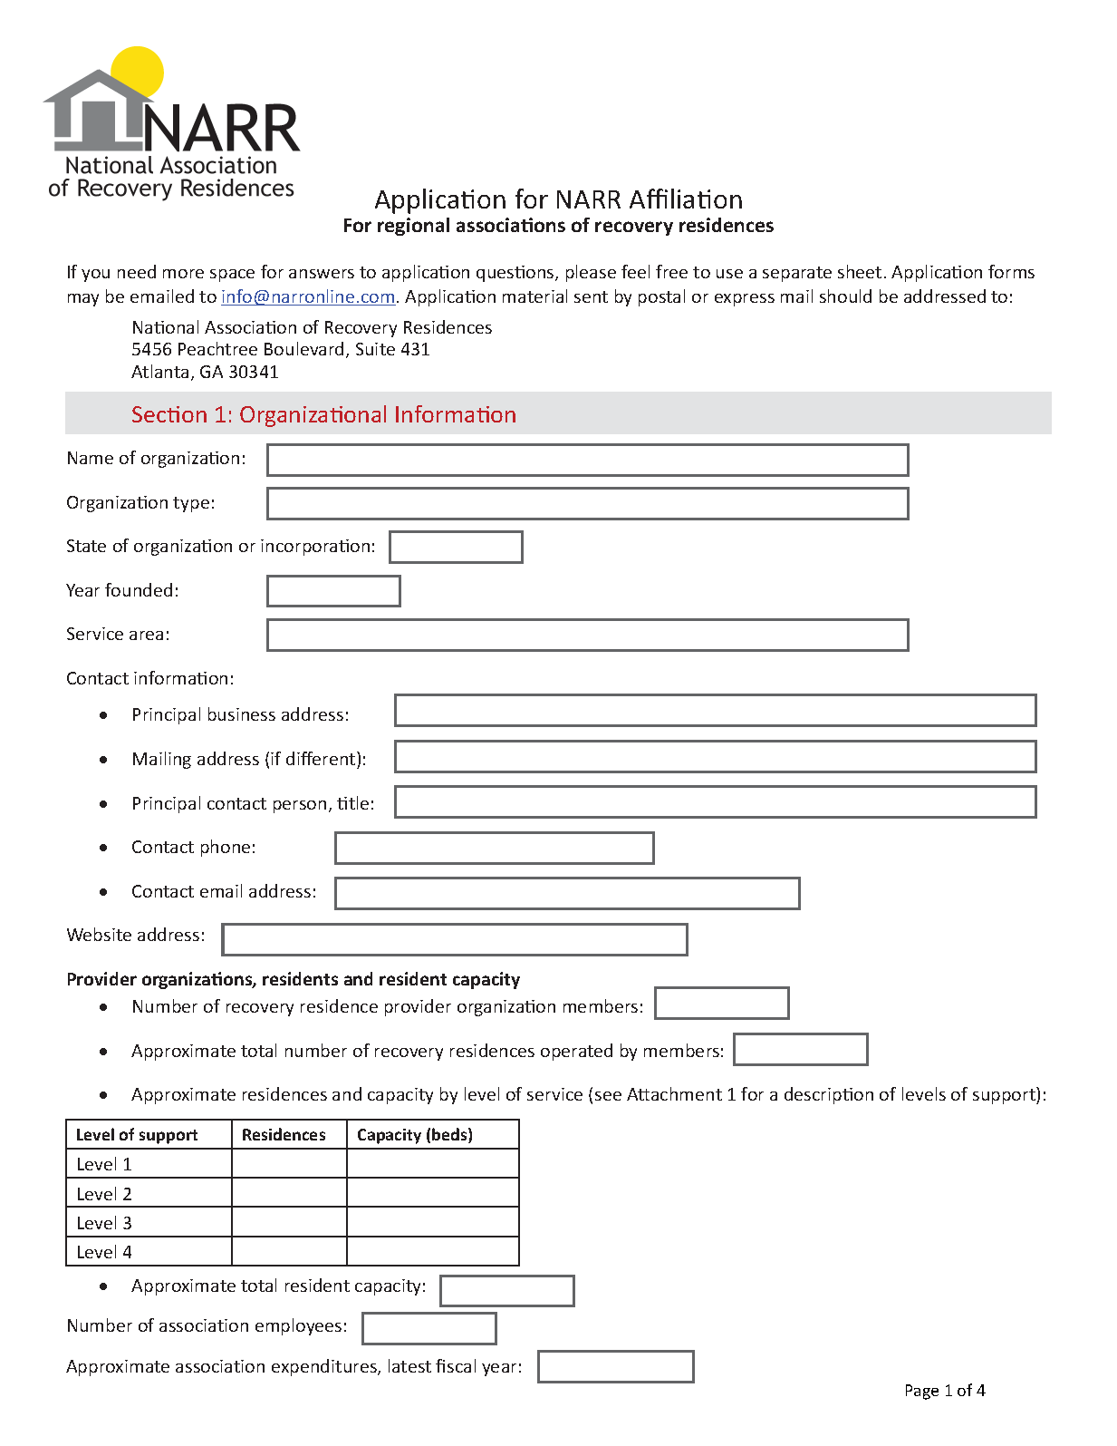
Overview of NARR Criteria for Affiliated Organizations

Slide 9
Criteria: Organizational Structure
Defined membership (minimum two providers)
Formal organizational, leadership structure
Formal process for membership applications, renewals
Regular meetings
Nonprofit organization or unincorporated association

Slide 10
Criteria: Standards for members
Formal standards for members, residences
Code of Ethics or equivalent
Defined process for administering standards
Defined process for resolving disputes (residents, members, public)
Agree to adopt NARR Standard for Recovery Residences as minimum for own standards

Slide 11
Criteria: Records management
Membership records
Disputes, complaints, resolution
Financial records, including statements to members

Slide 12
Criteria: Contribution to NARR mission
Participation in NARR committees, activities (subject to resource constraints)
Data collection and research efforts
Financial support
Cooperation in resolving complaints we receive

Slide 13
Organizing Basics
Focus on your shared purpose
If you’re new and small, keep it simple:
  What work needs to be done?
  What decisions have to be made?
  How will you attract members?
  Who answers the phone?
  Who handles communication?
Who needs to be part of your group?

Slide 14
Organizing details
Organizational form
  Nonprofit status, or
  Unincorporated association
President, Secretary, Treasurer, other offices
Board of Directors? Advisory Board?
Nominations, elections
Committees and committee work
Operating rules (bylaws or equivalent)

Slide 15
Membership basics
What are your standards? (adopt, modify, evolve with experience)
Code of Ethics
Application form, supporting material
Inspections, related
Costs, member charges
Keeping records

Slide 16
Communication
Every stakeholder is an audience
Membership, residents
Non-member providers
Recovery community
Professional community
State, local regulators
Civic groups
???

Slide 17

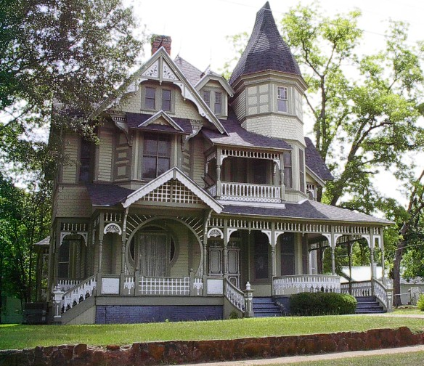
Perceptions and reality

Slide 18
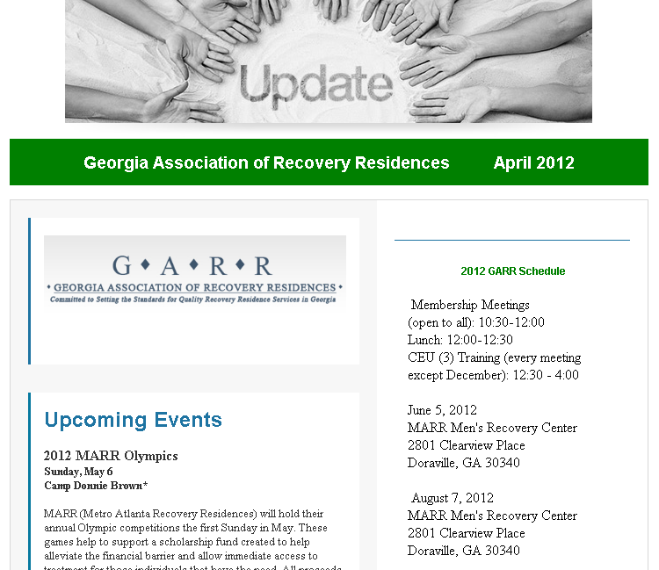
e-Newsletters, email blasts
Announcements
Events
News
Tips
Member items
Promote alliances
Community interest
Donations

Slide 19
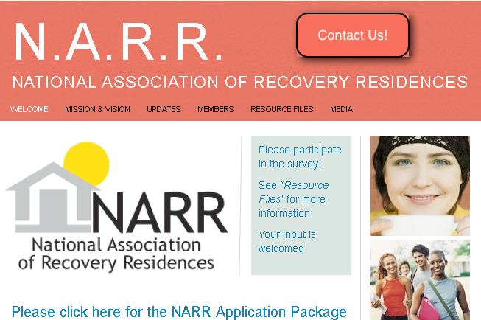
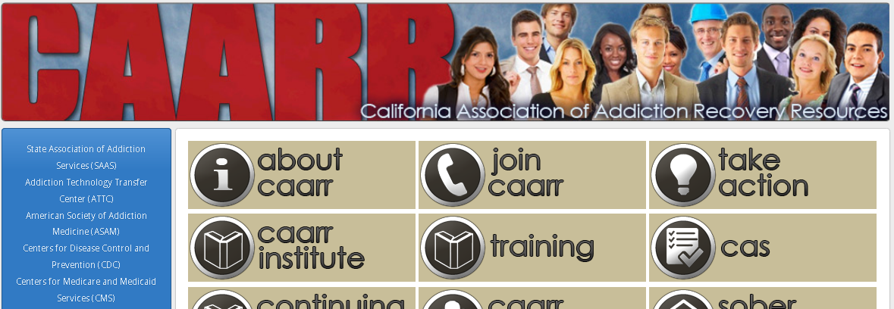
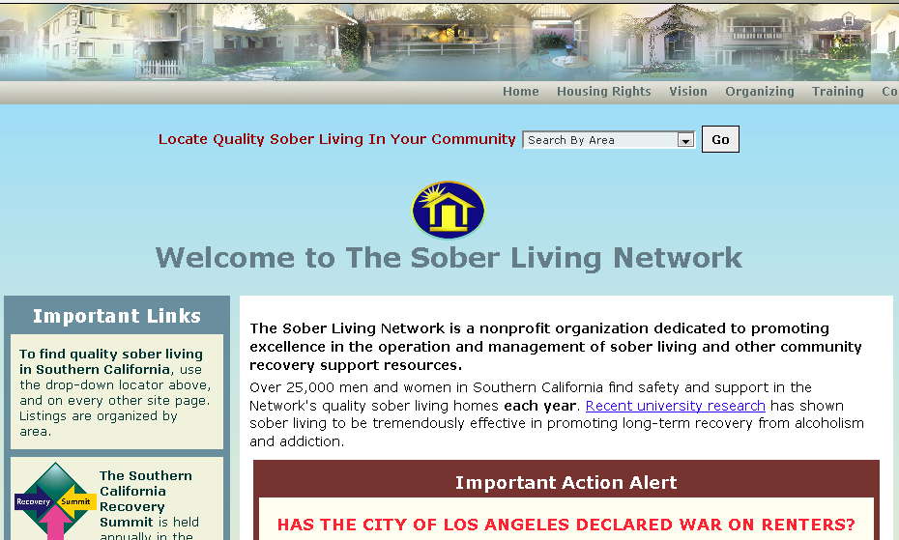
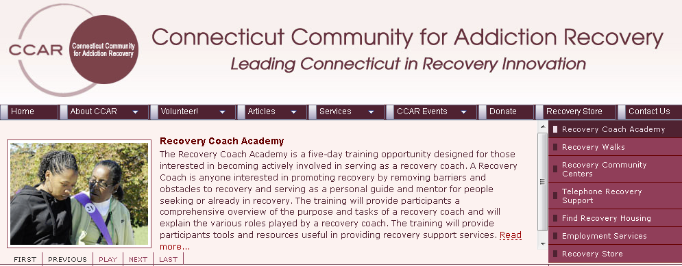
Website

Slide 20
Outstanding recovery residence ecosystems don’t emerge by chance
Communicating the value of strong recovery residence provider organizations:
Benefits to the community
Expanded opportunities for people in need
Value to members

Slide 21
Wide range of residence quality
Outstanding
Challenges are different for each level of quality.
Homes vary from outstanding to unacceptable
Unacceptable

Slide 22
Value of strong regional organizations
More
capacity
No support
Strong support
Outstanding
Limited capacity
Generally poor quality
Better capacity
Unacceptable
Notes:
Coalitions raise the average quality of homes, and create the infrastructure necessary for more homes to open and be successful.
They can’t eliminate all the bad or substandard homes, but coalitions can create conditions that make it more difficult for substandard homes to operate.

Slide 23
Value of strong regional organizations
Your
members
No support
Strong support
Outstanding
Unacceptable
Notes:
Coalitions raise the average quality of homes, and create the infrastructure necessary for more homes to open and be successful.
They can’t eliminate all the bad or substandard homes, but coalitions can create conditions that make it more difficult for substandard homes to operate.

Slide 24
Inclusion and barriers
Membership costs
Standards that tend to exclude
Poor outreach, communication
Favoritism
Failure to support members

Slide 25
Other important issues
Training
  Requirements
  Opportunities
Meetings
Inspections
Dispute resolution
Outreach, advocacy, housing rights

Slide 26
Financial support
Membership fees
Program service revenues
Donations, grants
Contracts
State, local government partnerships
But first …

Slide 27
Perform core functions extremely well
Attract significant membership support
Build recovery, mental health, social services relationships

Slide 28
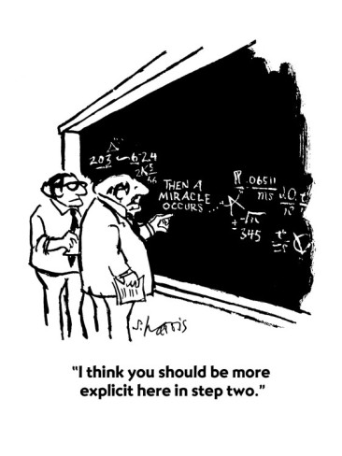
Questions, discussion
Then a miracle occurs

Slide 29
Managing expenses
Can be low, but not zero
Much depends on volunteers, skills
Expenses increase with size, geographic reach
Don’t neglect support functions

Slide 30
Operating costs
Website, email
Printing, design (brochure, business cards)
Reimbursed travel
Inspections
Phone line (can be virtual)
Association fees (NARR, other)
Housing rights fund (urgency varies)

